Slide 1
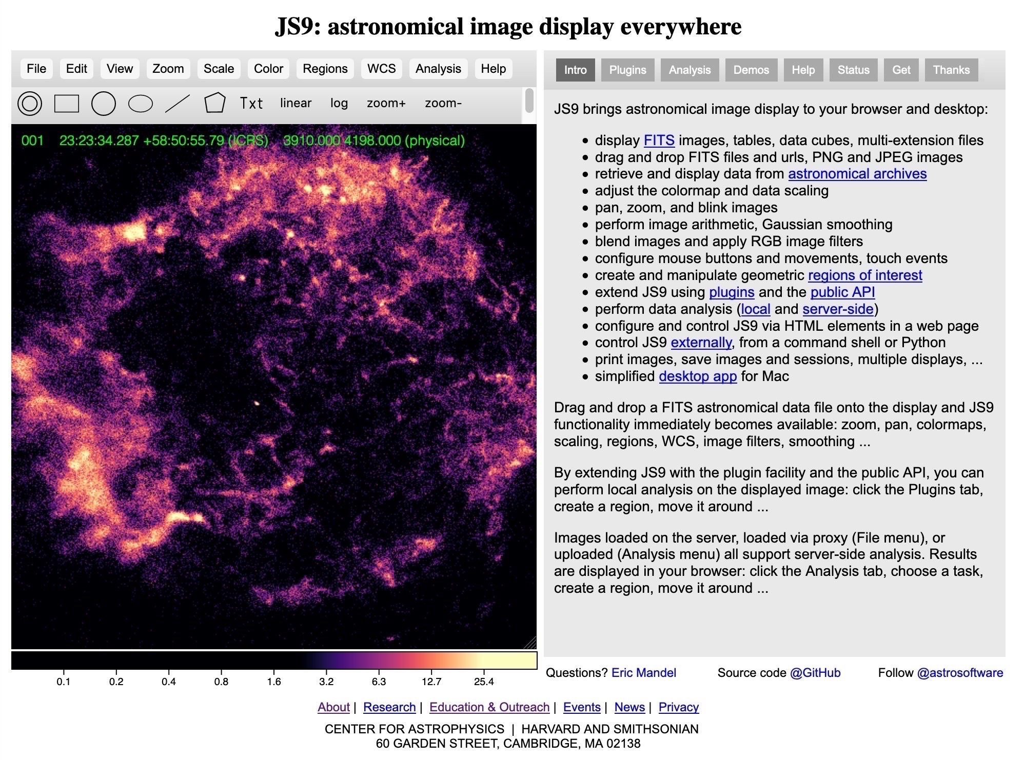
Analyzing Astronomy Data
with js9 on the web

Slide 2
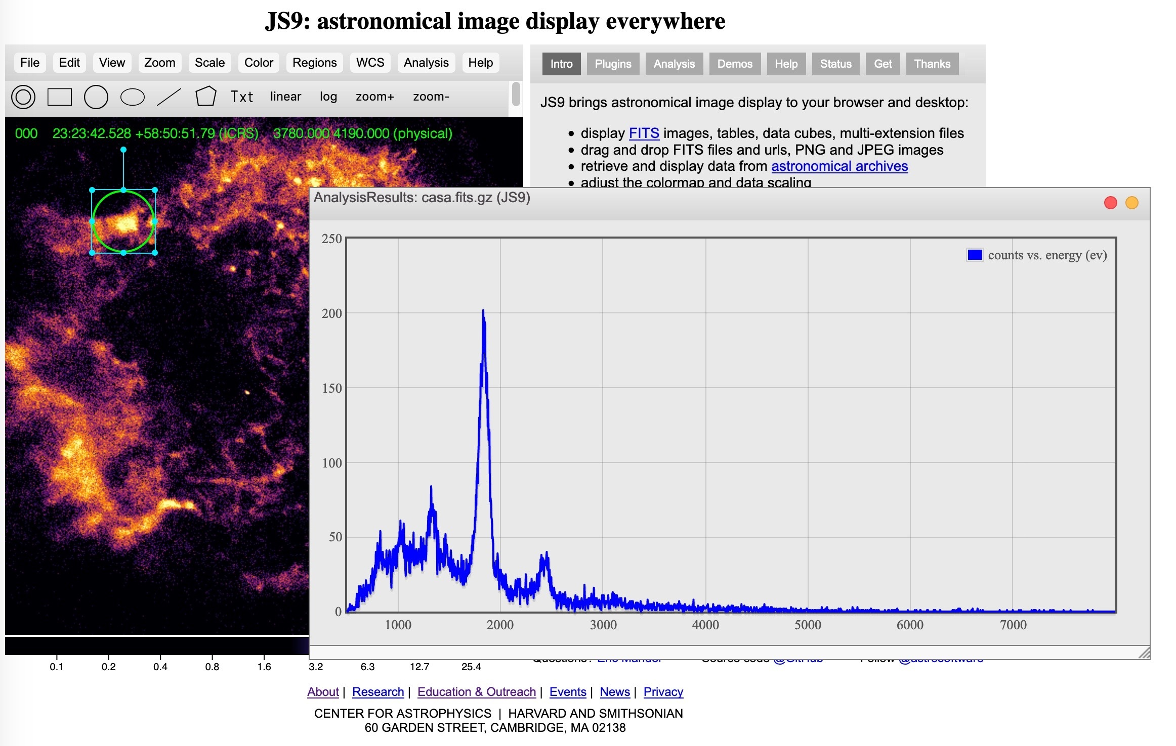
What is js9? It...
brings astronomical image display and analysis to your browser.
runs on runs on Macs, Linux, Windows, iPads, iPhones, ...
puts the tools of astrophysicists into the hands of students to do their own investigations and research!

Slide 3
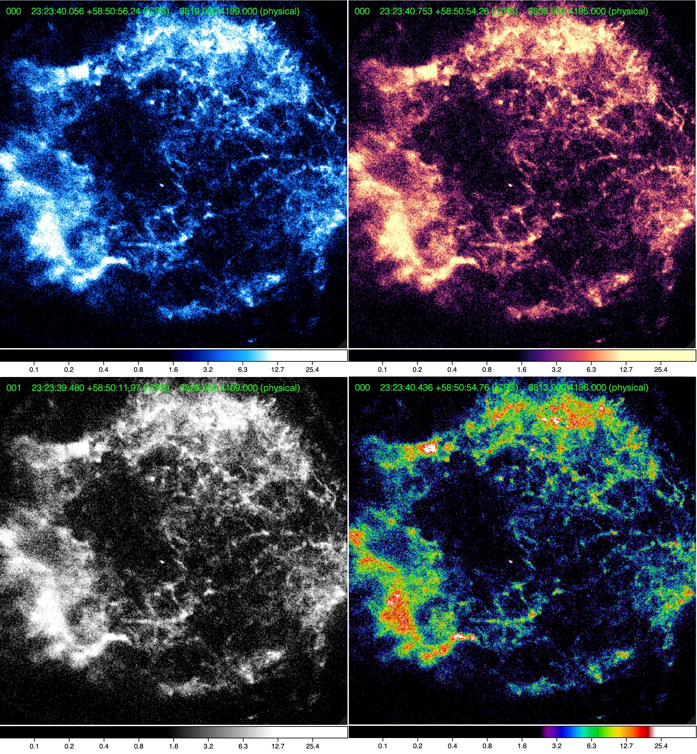
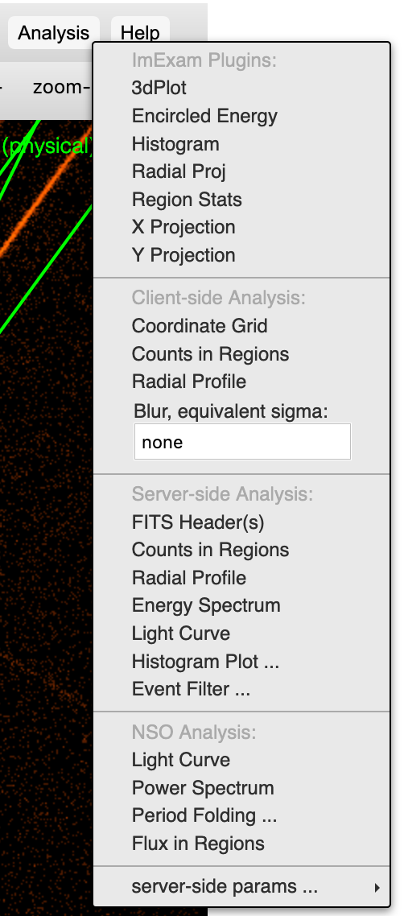
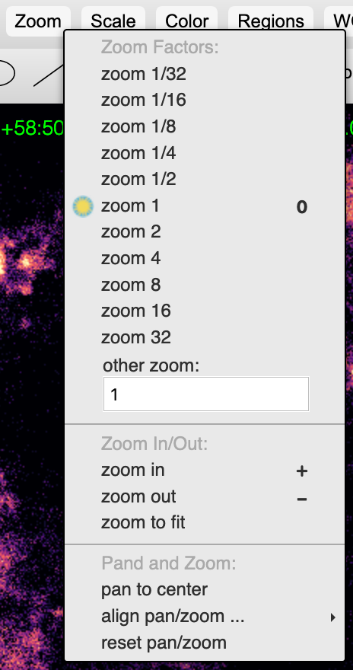
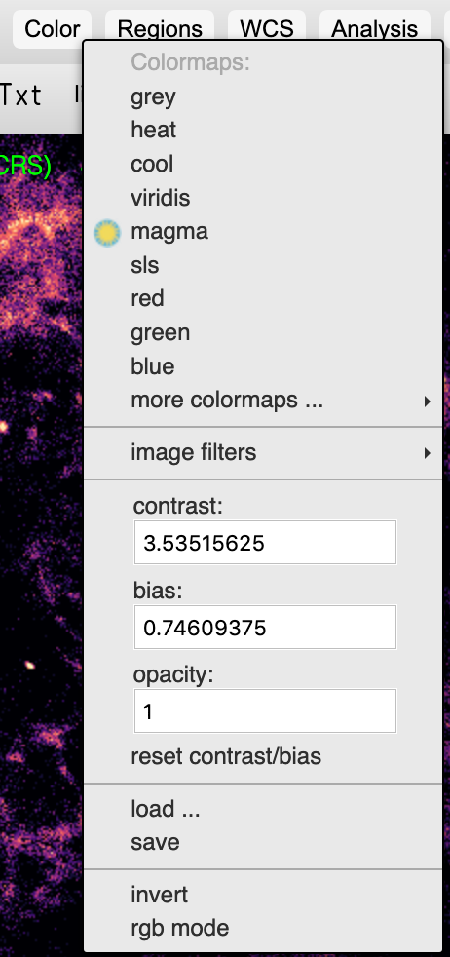
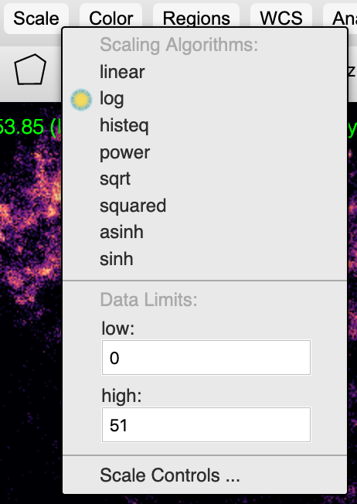
Js9 is easy to use with pull down menus
By loading a FITS astronomical data file into js9, you can view the data in different ways to show features that interest you. Change zoom, scale, color, contrast and bias, etc. Various analysis tools such as energy spectra and light curves are also available.
supernova remnant Cassiopeia A
displayed in various colormaps

Slide 4
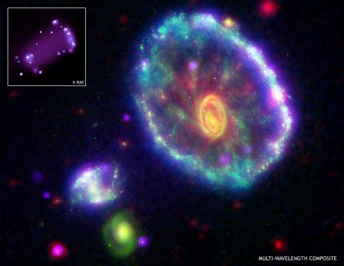
Self contained activities with js9, learn about
making 3 color composites to show regions of different energy bands
analyzing energy spectra to classify a supernova remnant as type 1a or type 2
using light curves to differentiate between white dwarfs and neutron stars
examining star formation in a galaxy in both optical and x-ray bands to determine the sources of the ultra- and hyperluminous x-ray sources.
The Cartwheel Galaxy

Slide 5
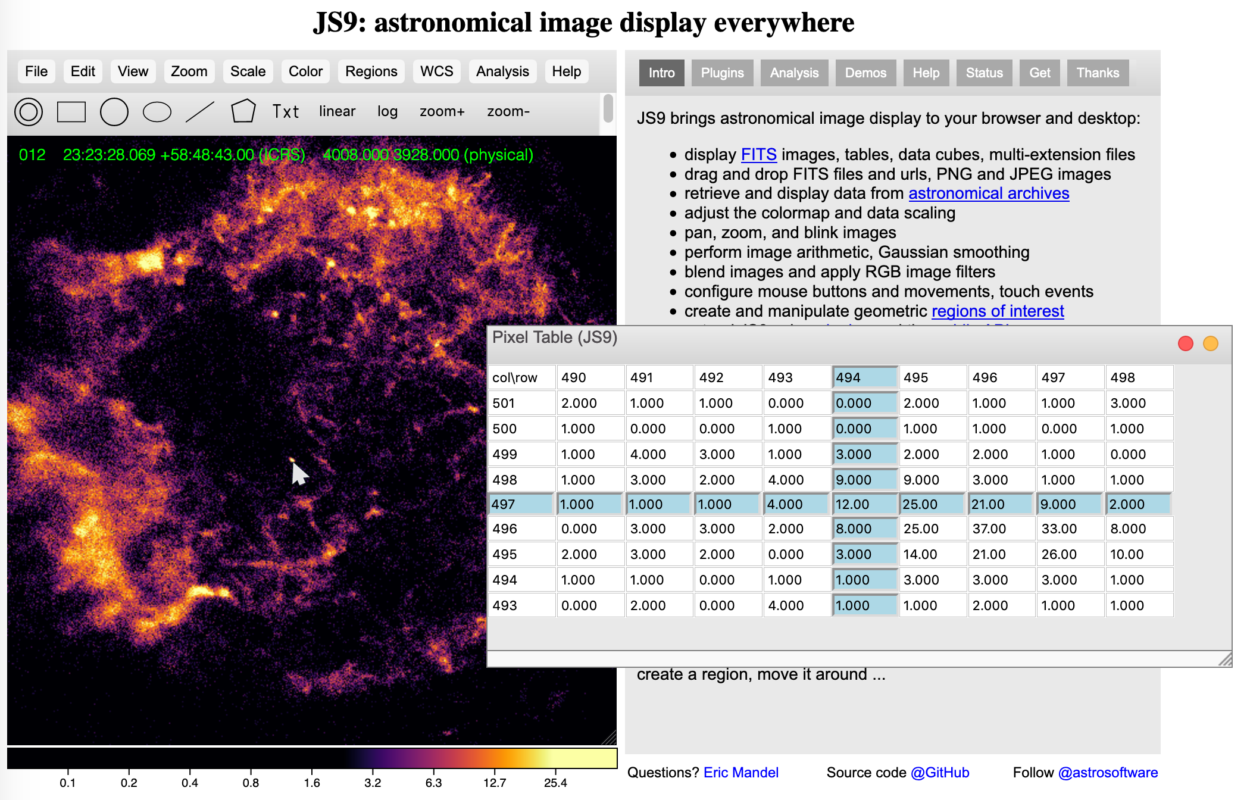
False color images
Images taken by telescopes that observe at the "invisible" wavelengths are sometimes called "false color images."
Colors used to make them are not "real" but are chosen to bring out important details such as intensity or brightness or a region or energy.
The green number in the upper left corner is the number of photons in the selected pixel. The pixel table from the “View” menu also shows this count. The bar at the bottom shows how colors represent this pixel intensity.

Slide 6
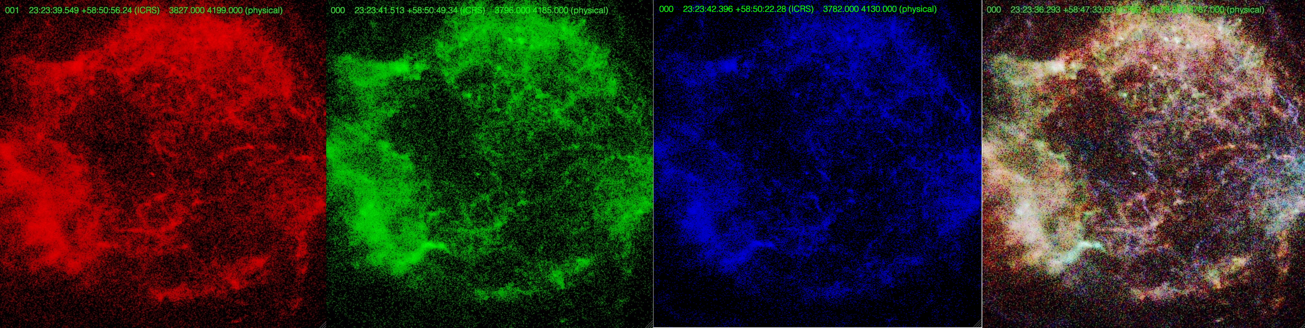
Activity #1 “Making a 3-color composite”
Use the “event filter” under the “Analysis” menu to produce three images showing x-rays in the soft, medium and hard energy ranges for Cas A.
In the “Color” menu, choose the red, green and blue color maps for each of the energy ranges respectively and then “rgb mode.”
600-1650 eV 1650-2250 eV 2250-7750 eV 3 color composite

Slide 7
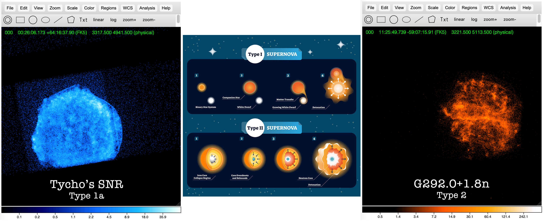
Activity #2 “X-Ray Spectroscopy of SNRs”
Can you tell a type 1a from a type 2 supernova by the x-ray energy spectra?

Slide 8
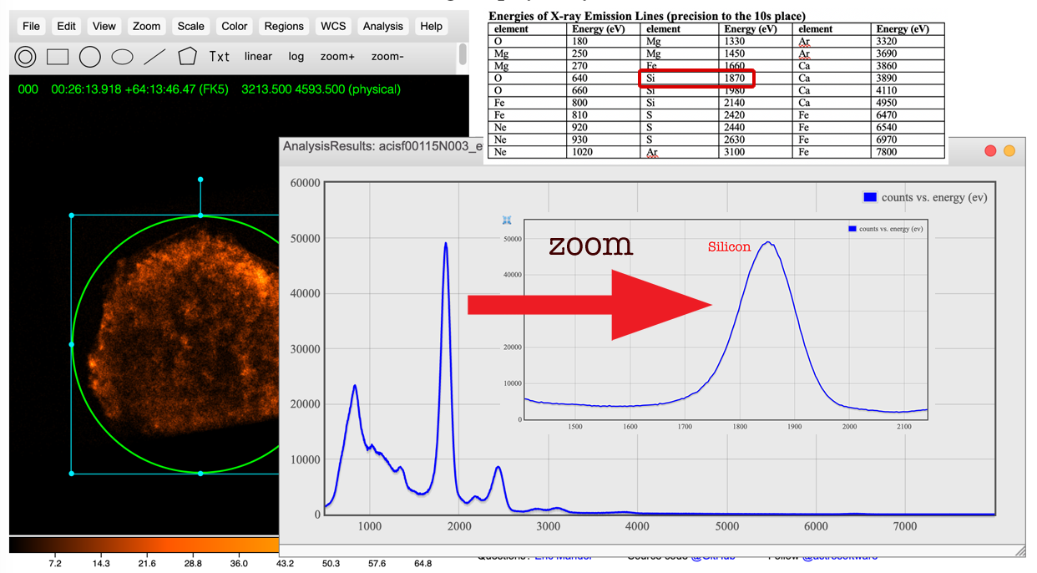
Produce an Energy Spectrum
Upload the FITS file to make tasks available.
Draw a circular region around the SNR and go to Analysis>Energy Spectrum
Zoom in on spectral peaks and compare energies to a table to identify elements.

Slide 9
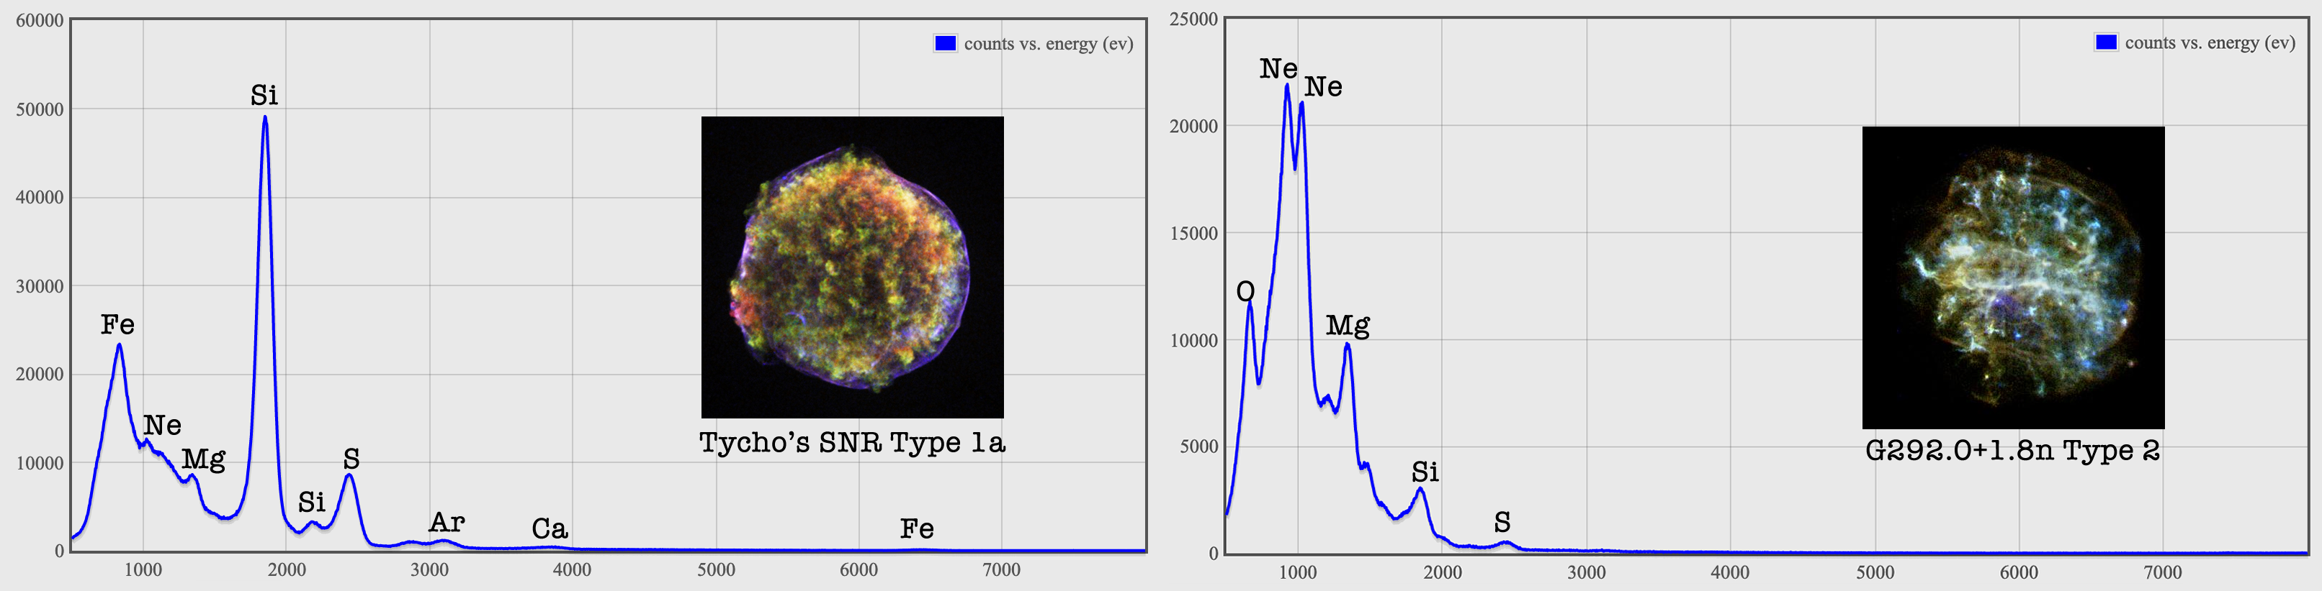
Spectra of Type 1a vs Type 2 SNR
Type Ia remnants (from white dwarfs) should have relatively strong Si, S, Ar, Ca, and Fe, and weak O, Ne, and Mg
Type II (from massive stars) generally have the reverse pattern.
Sometimes, due to interstellar absorption, emission lines less than 1500 eV are not seen. How could this affect the classification of a supernova remnant?

Slide 10
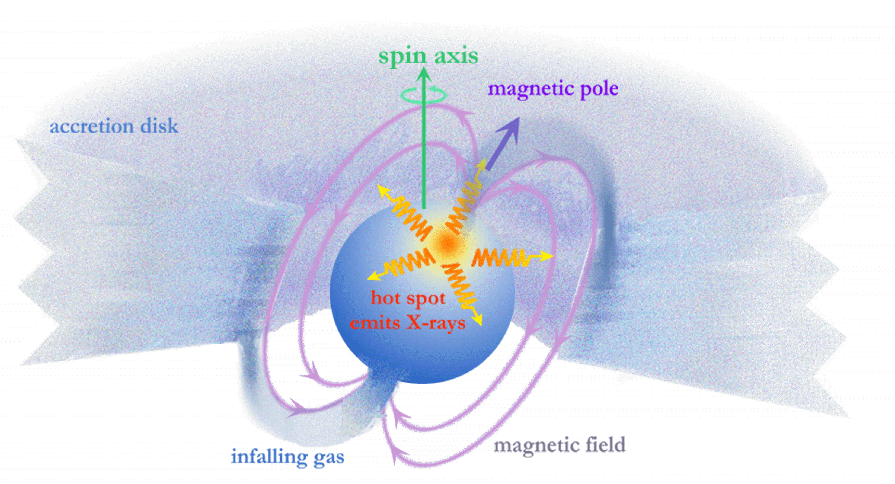
Activity #3: Analyzing X-Ray Pulses of Stellar Cores
White dwarfs and neutrons stars can have “hot spots” in x-rays due to accretion of material from a companion star
If offset from the spin axis, hot spots rotate in and out of sight so variations in X-ray brightness display some regularity.
The period of light curves can be used to determine rotation rate and if the stellar cores could be white dwarfs and/or neutron stars.
Illustration of an Accretion Powered Pulsar

Slide 11
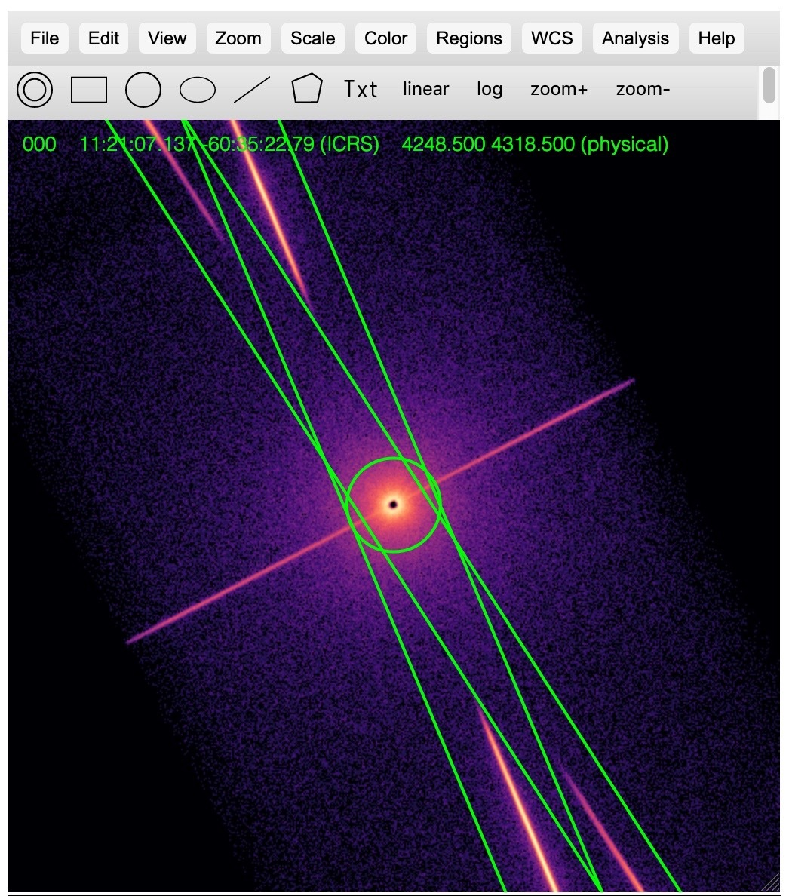
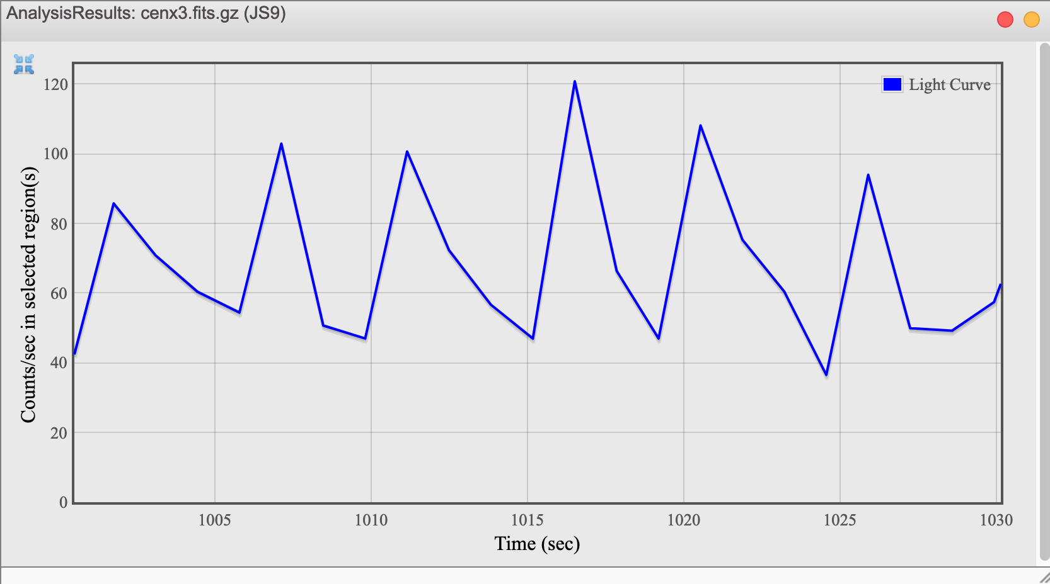
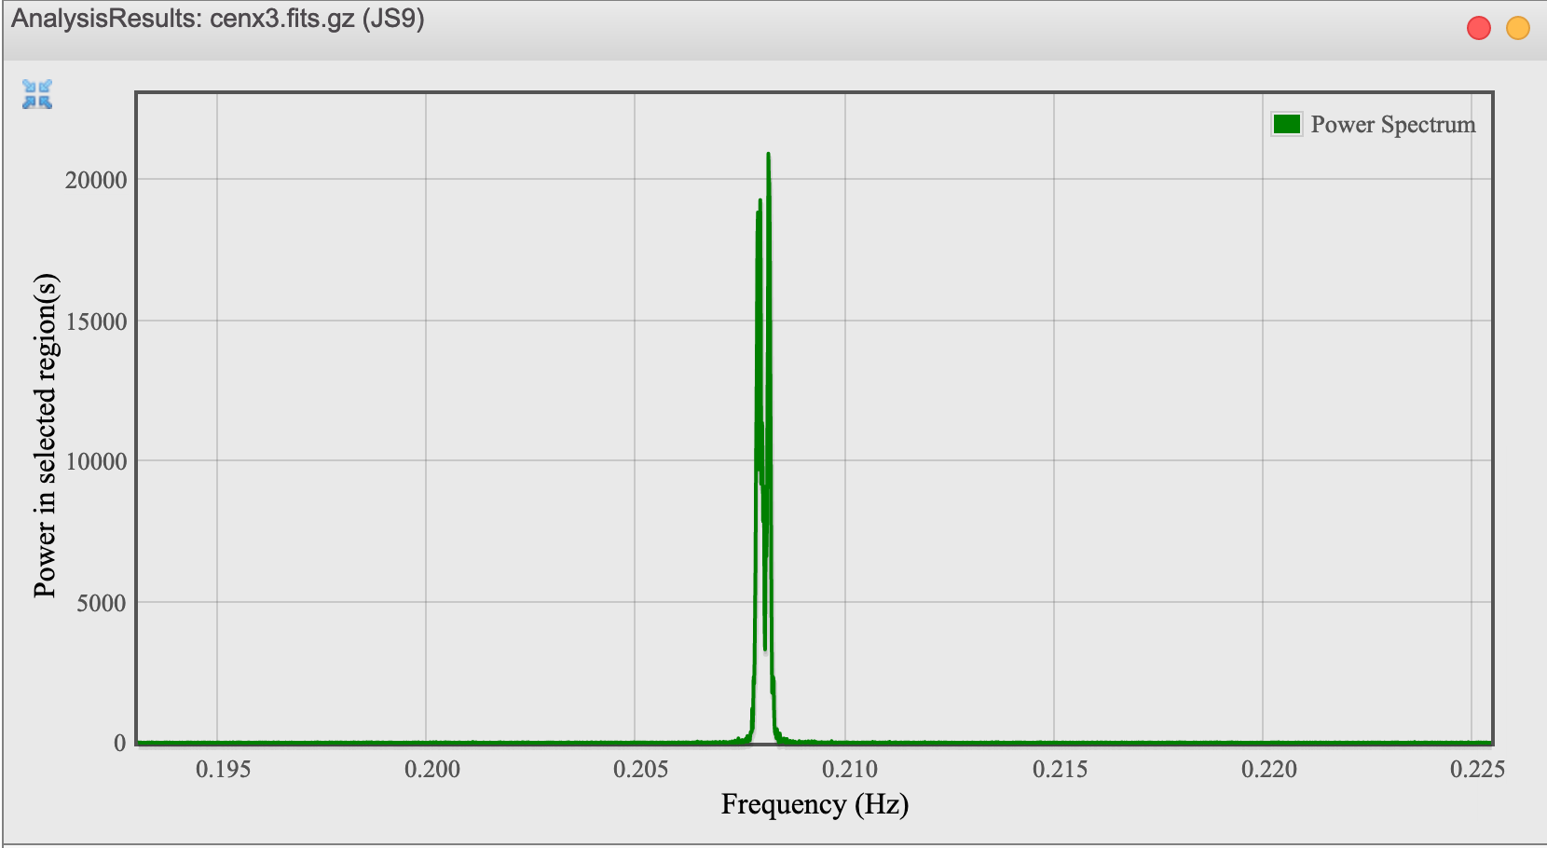
Period of Rotation of Cen X-3
Light curve gives a period of ~5 s.
Power spectrum (a Fourier transform which searches for periodicity) gives a peak at 0.208 hz corresponding to a period of 4.81 s

Slide 12
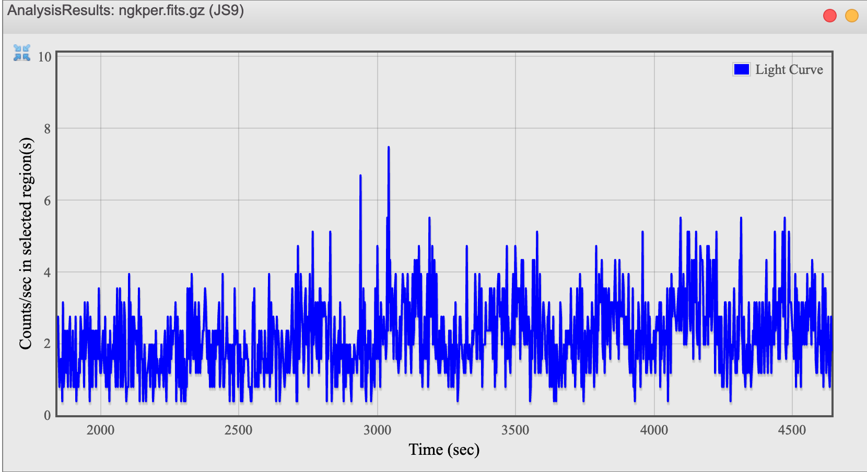
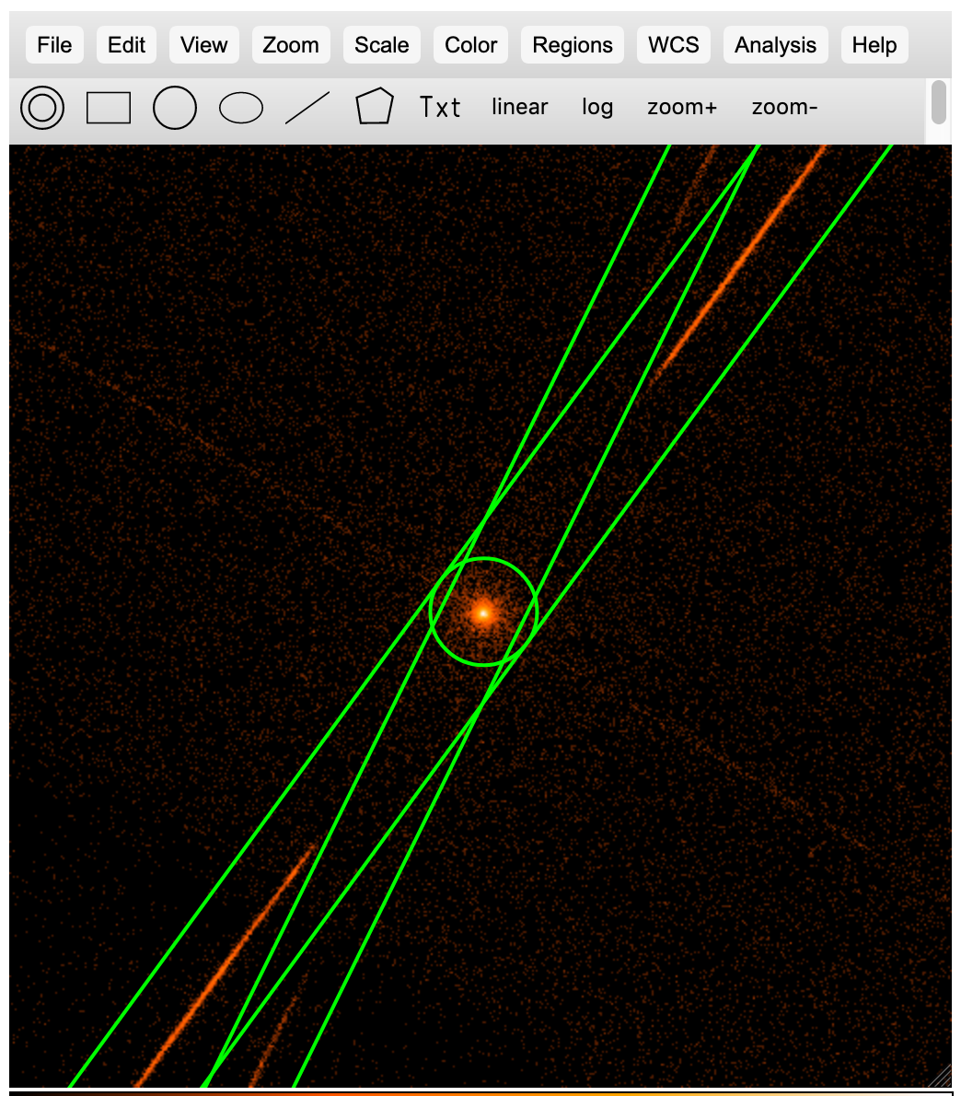
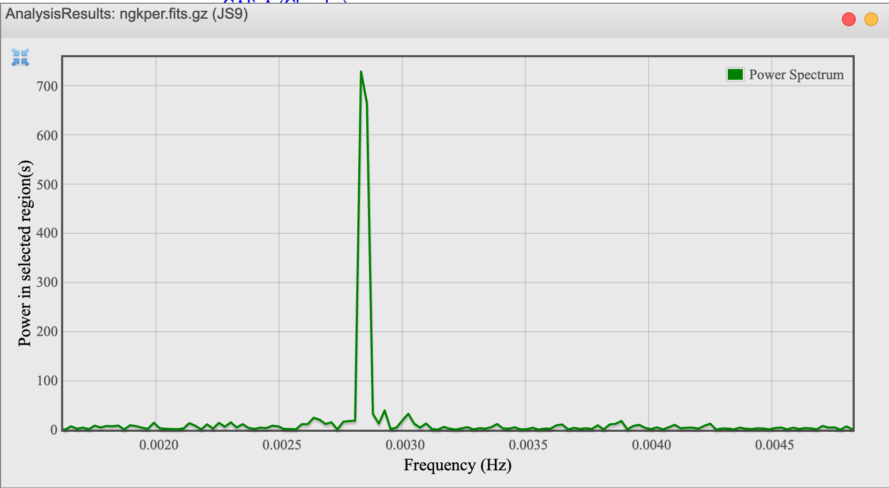
Period of Rotation of GK Per
Light curve gives a period of ~300 s.
Power spectrum gives a peak at 0.0028 hz or 0.0029 hz to two significant figures.

Slide 13
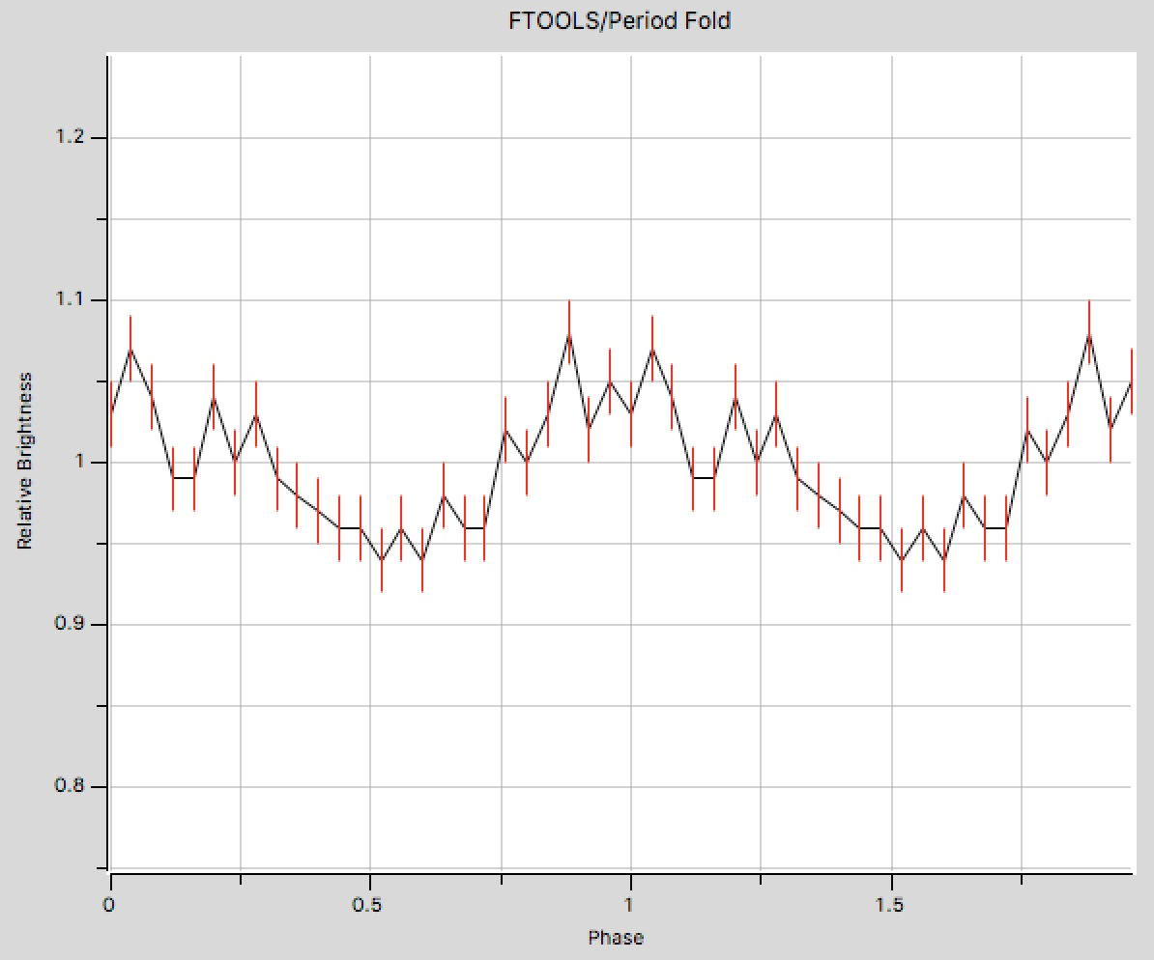
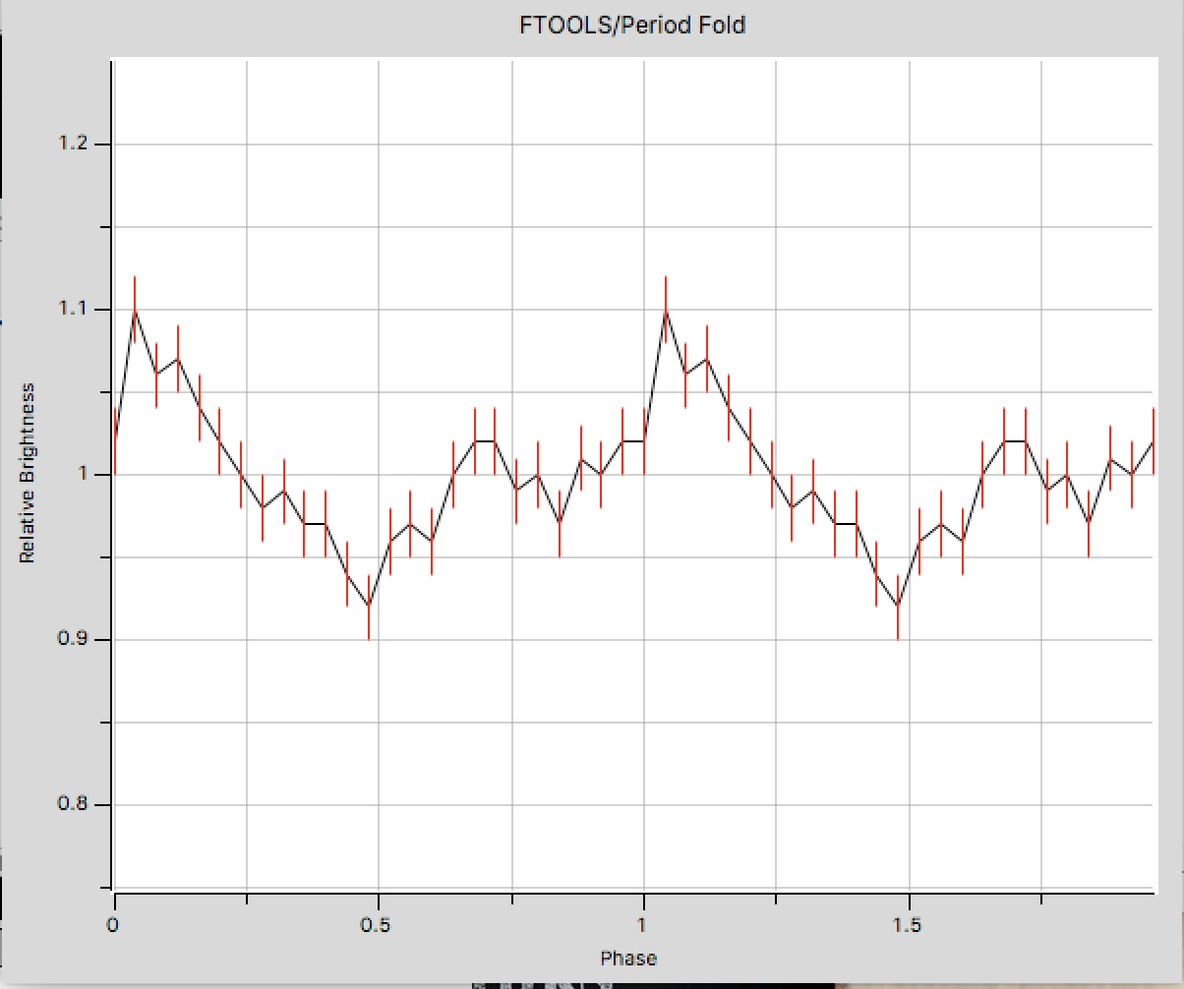
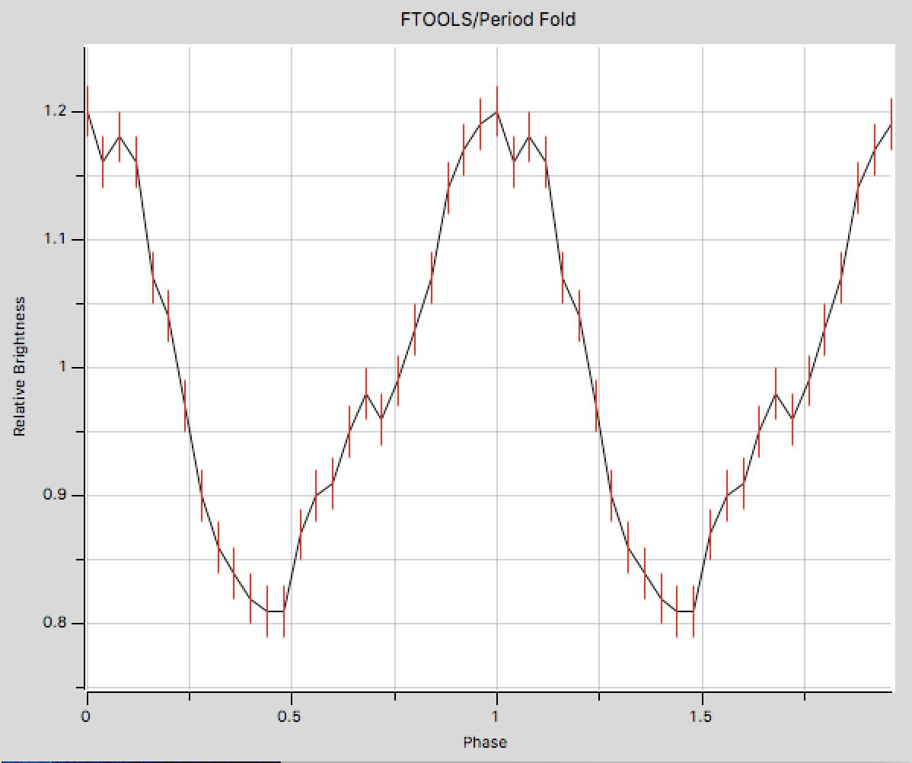
Try period folds over the possible range
Picture cutting the sine wave into sections one period long, and putting each cycle on top of the first one, adding all the sine wave sections together. If the sections are not all exactly one period, then when the sine waves are added, parts of the waves cancel out and the composite wave will have a smaller amplitude. Which period gives the best sine wave with the highest amplitude?
T=1/frequency. Trying various periods gives the best match at 351 s.
1/0.00280 hz = 357 s 1/0.00290 hz = 345 s 1/0.00285 hz = 351 s

Slide 14
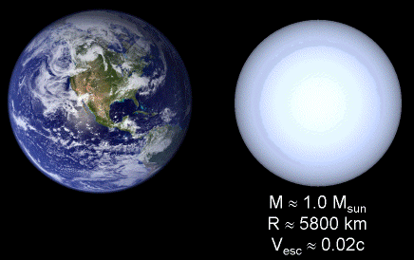
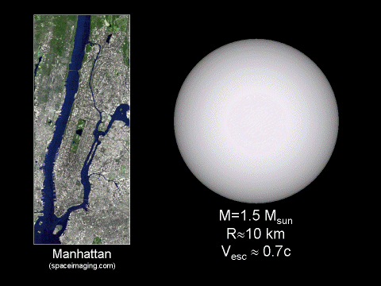
Compare centripetal and gravitational acceleration
If the centripetal acceleration on the material on the star’s surface for a given period is less than the acceleration due to gravity, the gravitational force would be enough to hold the material on the surface and the star could sustain such a period without disruption.
These accelerations are calculated using the determined periods of rotation, as well as typical masses and radii for a white dwarf and a neutron star.
Comparison of a White Dwarf
and the Earth.
Comparison of a Neutron Star
and the Island of Manhattan.

Slide 15
Activity #4: U/HLX’s in the Cartwheel Galaxy
Examine star formation in the Cartwheel Galaxy in both optical and x-ray bands
Determine the sources of the ultra- and hyperluminous x-ray sources.
“The unusual shape of the Cartwheel Galaxy is likely due to a collision with one of the smaller galaxies on the lower left several hundred million years ago. The smaller galaxy produced compression waves in the gas of the Cartwheel as it plunged through it. These compression waves trigger bursts of star formation. “
Credit: Composite: NASA/JPL/Caltech/P.Appleton et al. X-ray: NASA/CXC/A.Wolter & G.Trinchieri et al.
https://chandra.harvard.edu/photo/2006/cartwheel/

Slide 16
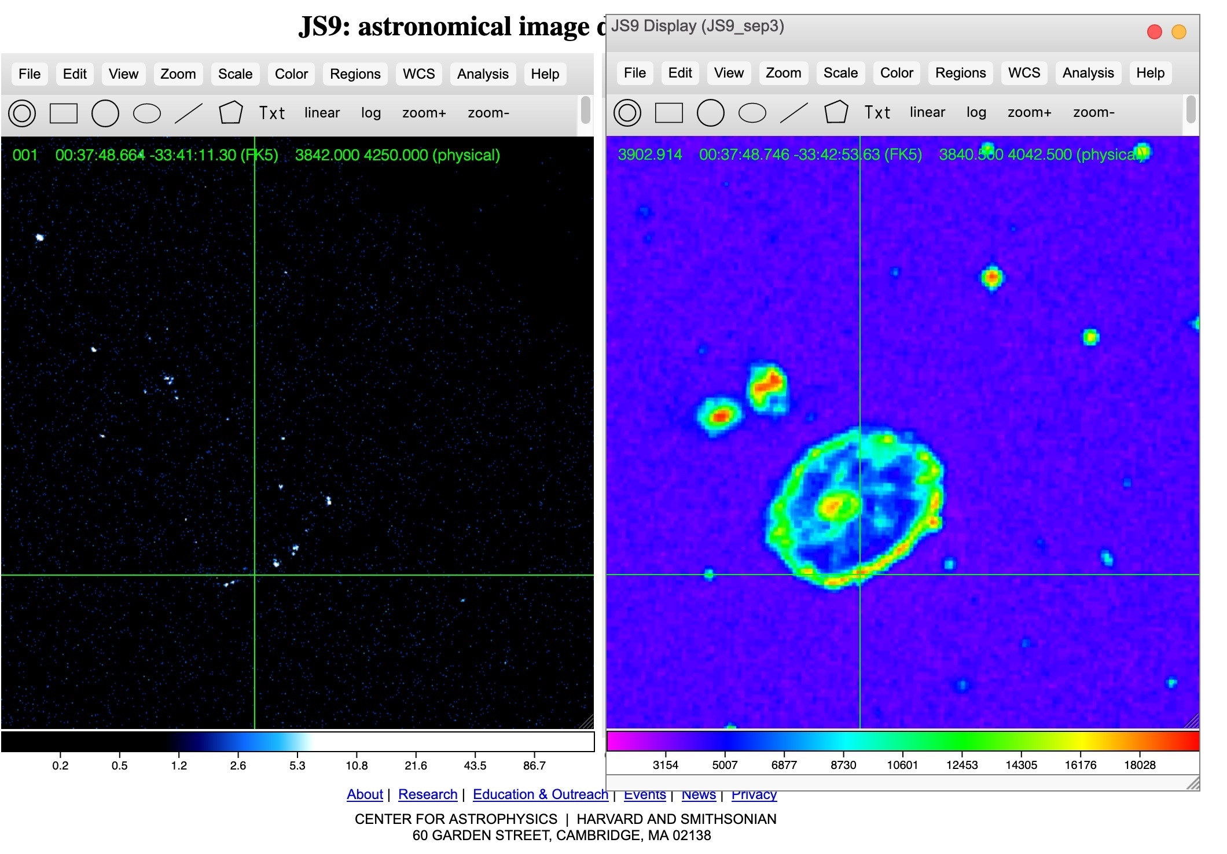
Within js9, retrieve the optical image
Synchronize crosshairs to move them simultaneously over points of interest in the x-ray (left) and optical (right) images.

Slide 17
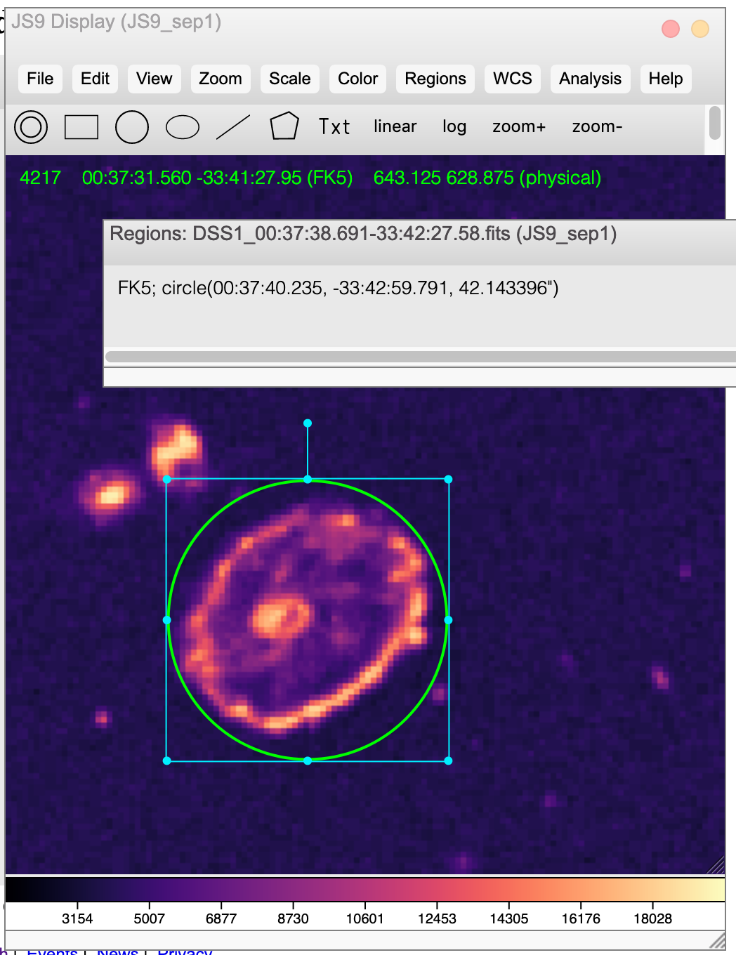
Determine approximate time of collision
In js9, find the size of the Cartwheel’s ring using a circular region as shown to the left. This radius is in arc sec and can be converted to radians. The size in light years is found using the small angle formula and a distance of ~380 million ly.
Use the expansion rate of 200,000 miles per hour to determine about when the smaller galaxy collided with the Cartwheel. (~ 300 million years ago)

Slide 18
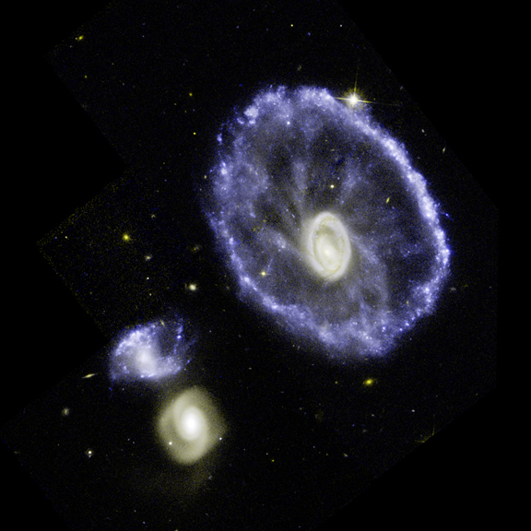

Optical vs X-ray Images
Bright blue knots of star formation in the Cartwheel’s Ring in the Hubble image on the top correspond to ultra- and hyperluminous x-ray sources in the Chandra image on the bottom.
X-ray sources along the ring could be supernova remnants, neutron stars or black holes because the lifetime of a massive star is less than 300 MY which is about when the galaxy collision occurred and new star formation was triggered.
(Credit: NASA/JPL/Caltech/P.Appleton et al.)
(Credit: NASA/CXC/A.Wolter & G.Trinchieri et al.)

Slide 19
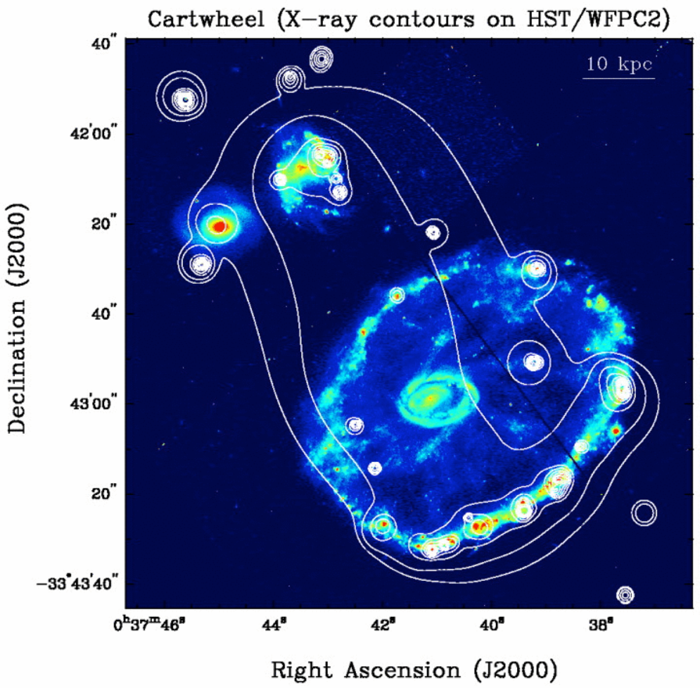
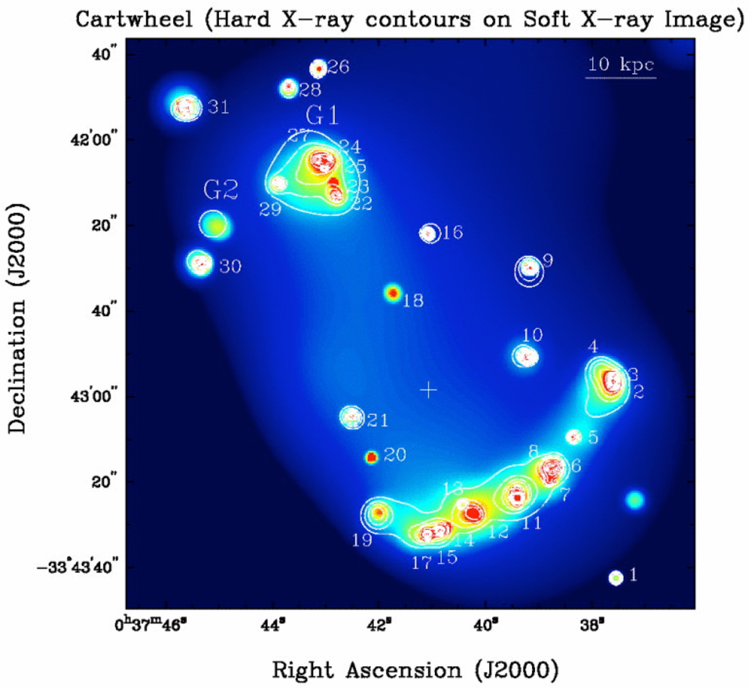
Students can compare their results to those of astrophysicists!
“The two most likely sources of X-ray emission associated with massive young star-forming regions are probably supernovae (SNe) or extremely young SN remnants (SNRs) and the high-mass X-ray binaries (HMXBs). We can almost rule-out low-mass X-ray binaries (LMXBs) to be the significant sources for H/ULXs along the Cartwheel narrow ring, although intermediate mass black holes (IMBHs, see review by Miller & Colbert 2003) are likely viable. It is conceivable that LMXBs and/or background sources could be responsible for the three ULXs interior to the ring. Three “ULXs” outside the Cartwheel with faint optical counterparts are likely background galaxies. “ Nonnuclear Hyper/Ultraluminous X-Ray Sources in the Starbursting Cartwheel Ring Galaxy, Yu Gao,¹ Q. Daniel Wang,¹ P. N. Appleton,² and Ray A. Lucas³, The Astrophysical Journal Letters, 596:L171–L174, 2003 October 20.

Slide 20
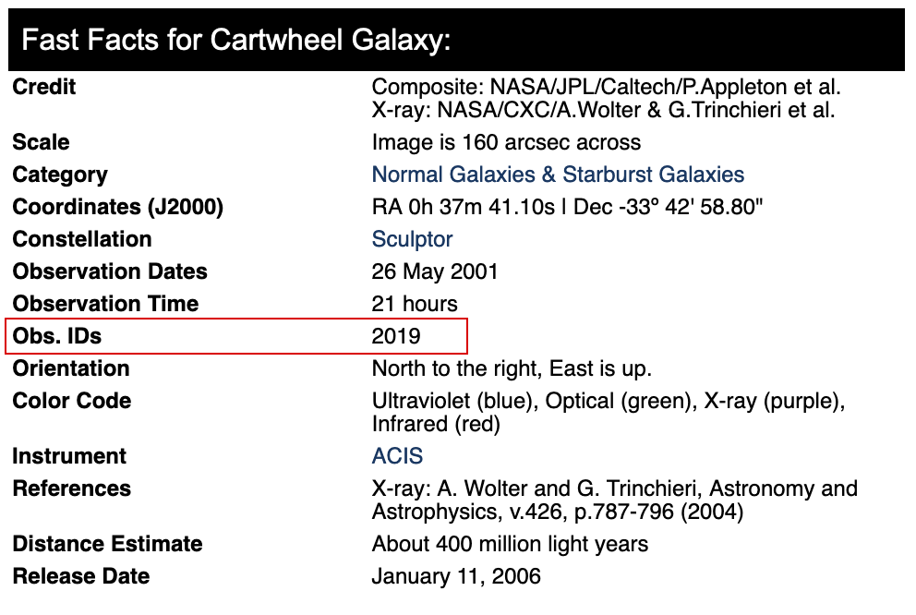
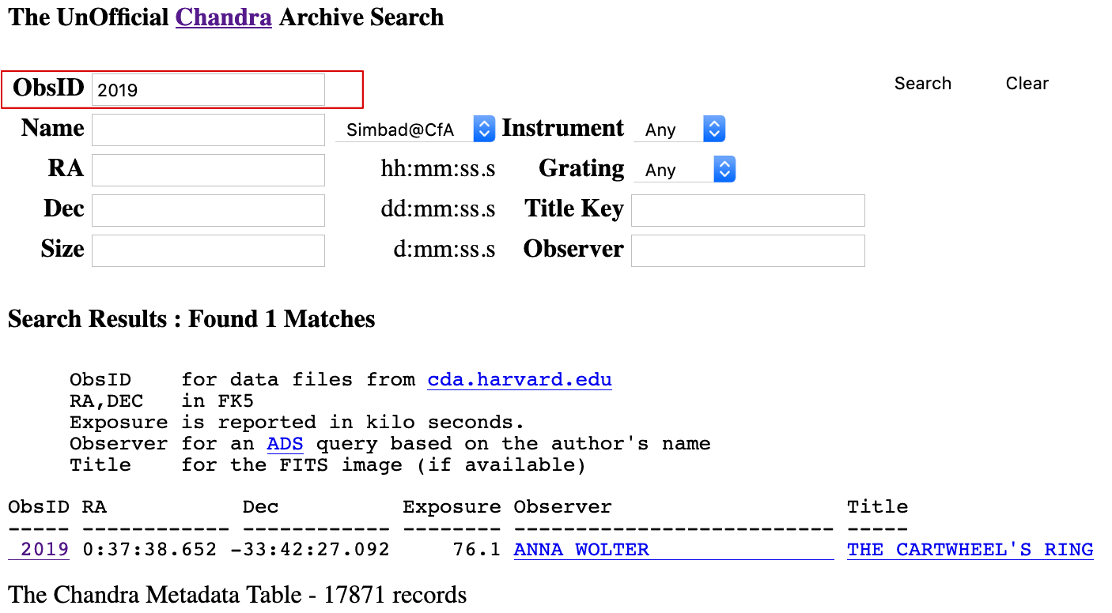
Finding x-ray FITS files for analysis in js9
Use the Unofficial Chandra Archive Search with the Observation ID found from the Chandra Photo Album
Great for students to find files to do their own research!
https://chandra.si.edu/photo/
https://www.cfa.si.edu/archive/chandra/search

Slide 21
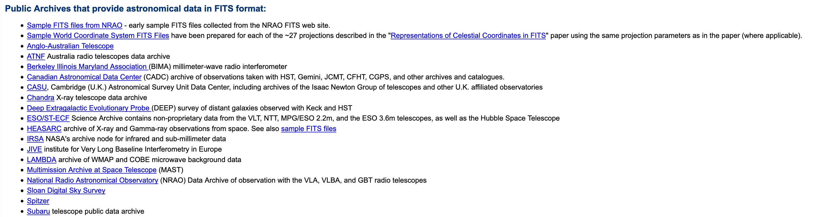
Load FITS files from other missions!
https://fits.gsfc.nasa.gov/fits_samples.html

