Slide 1

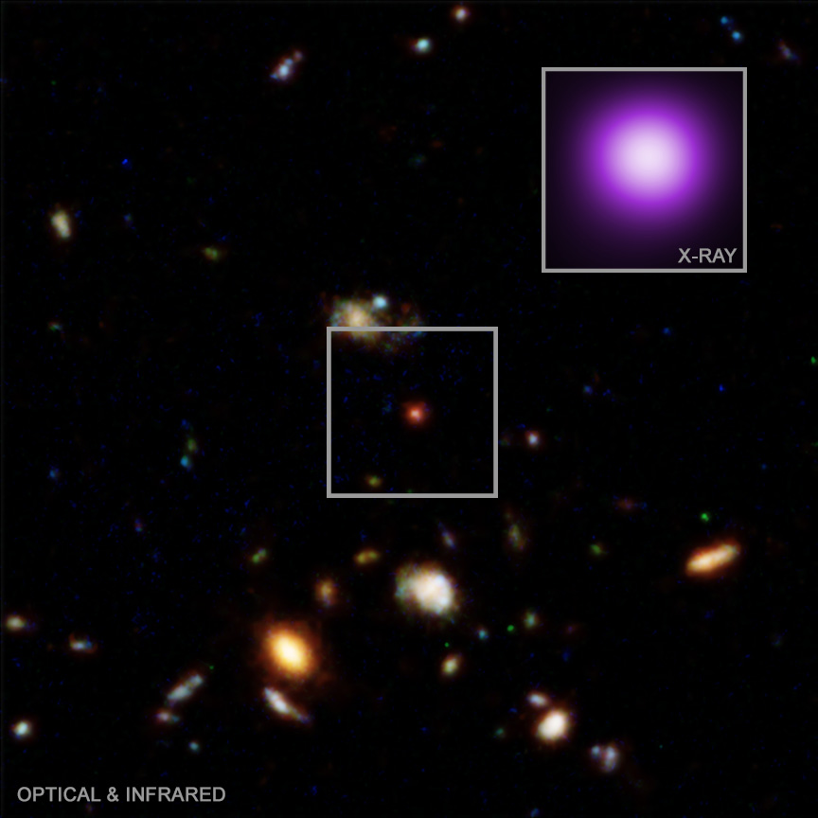
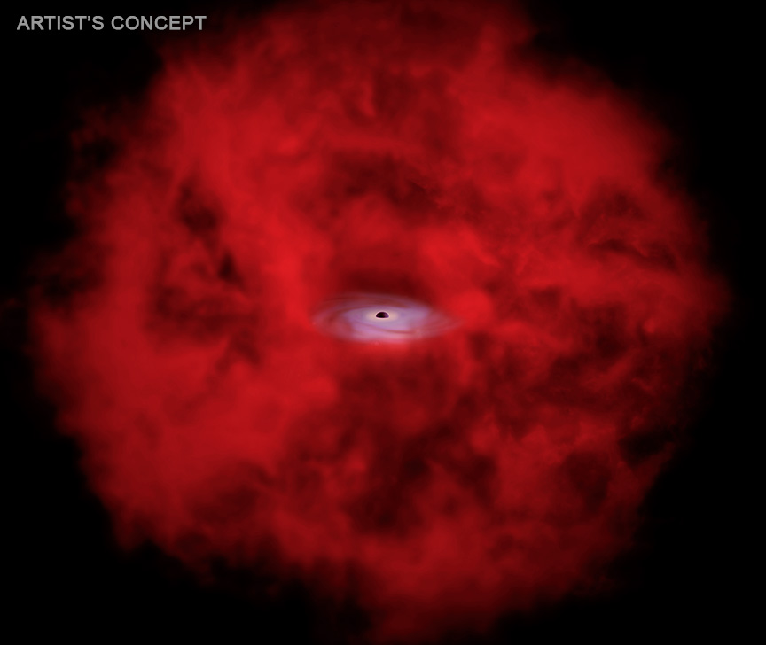

CHANDRA SCIENCE HIGHLIGHT: April 2026
National Aeronautics and Space Administration
NASA Connects Little Red Dots With Chandra, Webb
NASA’s Chandra X-ray Observatory has found a “little red dot” (LRD) — a class of small, red, distant objects — that is giving off bright X-rays, unlike others observed so far.
This suggests that this so-called X-ray dot represents a previously unseen phase of supermassive black holes in the early Universe.
In the proposed scenario, gas surrounding the growing black hole becomes patchy as the black hole consumes it.
Over time X-rays from material falling onto the black hole are then able to pass through, which Chandra can detect.
Distance estimate: 11.8 billion light-years from Earth
Credit: X-ray: NASA/CXC/Max Plank Inst./R. Hviding et al.; Optical/IR; NASA/ESA/STScI/HST; Image Processing: NASA/CXC/SAO/N. Wolk
Instrument: ACIS
Reference: Hviding, R.E., et al., 2026, ApJL, 1000, L18
More information: The detailed caption and other material are here: https://chandra.si.edu/photo/2026/xraydot/
“A unique, X-ray spewing black hole”
LIVE SCIENCE
The large image is an optical and infrared composite image centered on the position of the X-ray dot and shows two of its key features as an LRD – small and red. Optical light from NASA’s Hubble Space Telescope is colored blue and green and infrared light from Hubble is colored orange and red. The Chandra X-ray image of the X-ray dot (purple) is in the inset, showing the source is bright in X-rays.
An artist’s impression of the X-ray dot shows the research team’s understanding of this newly-discovered object: a growing supermassive black hole at the center of a large sphere of gas. As the black hole in the little red dot has consumed gas surrounding it, patchy holes in the clouds of gas have appeared. This allows X-rays from material falling onto the black hole to pass through, which are observed by Chandra.
The Chandra X-ray Center is operated for NASA by the Smithsonian Astrophysical Observatory

