Slide 1

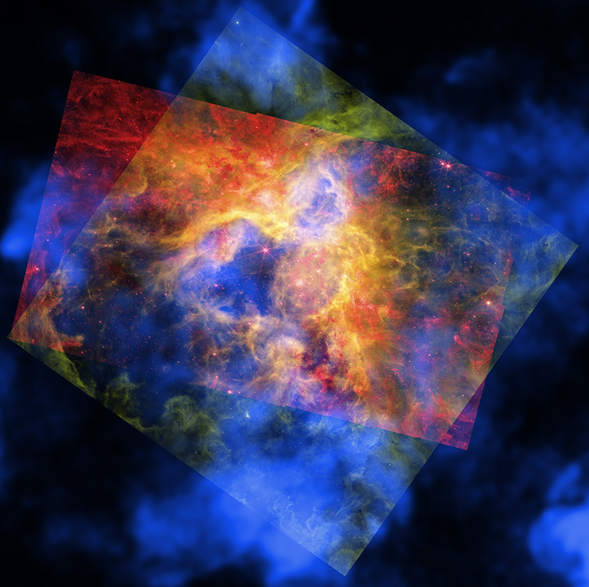
CHANDRA SCIENCE HIGHLIGHT: August 2026
National Aeronautics and Space Administration
NASA Telescopes Create Colorful 'Craft' From Nearby Nebula
The new composite image contains X-rays from NASA’s Chandra X-ray Observatory, appearing in blue and revealing gas blown away by winds from the surfaces of young, massive stars and heated to millions of degrees by shock waves, like sonic booms from supersonic jets. The red represents infrared data from NASA’s James Webb Space Telescope showing thousands of young stars, plus swaths of cool dust that will provide the ingredients to form new stars and planets. Optical data in the green layer from NASA’s Hubble Space Telescope uncovers hydrogen gas that is warmer than seen with Webb, as well as some individual stars through the nebula. In some regions the blue Chandra layer stands alone, and in others it combines with either the red Webb data or the green Hubble data. In the middle region all three images overlap to provide a holistic view in red, orange, yellow, green, and blue.
A new study of the Tarantula Nebula is answering questions about why this star formation region in the Large Magellanic Cloud is losing energy from its center.
Using data from Chandra, Hubble, Webb and Spitzer, researchers identified what has tamed the Tarantula and where the energy has gone.
Like a collage made of colored sheets of cellophane, this new composite image combines data from Chandra (blue), Hubble (green), and Webb (red).
Scientists have concluded that energy has been lost through leakage of gas, the mixing of hot and cold gas and by conduction of heat.
Distance estimate: 160,000 light-years from Earth
Credit: X-ray: NASA/CXC/Ohio State Univ./J. Rodriguez et al; Infrared: NASA/ESA/CSA/STScI; Optical: NASA/ESA/STScI; Image Processing: NASA/CXC/SAO/P. Edmonds
Instrument: ACIS
Reference: Rodriguez, J.A., et al, 2026, ApJ, 998, 318.
More information: The detailed caption and other material are here: https://chandra.harvard.edu/photo/2026/30dor/
“NASA reveals stunning image”
Yahoo
“Vibrant new photos”
“a genuinely striking composite image”
New York Post
Universe Today
The Chandra X-ray Center is operated for NASA by the Smithsonian Astrophysical Observatory

