Slide 1

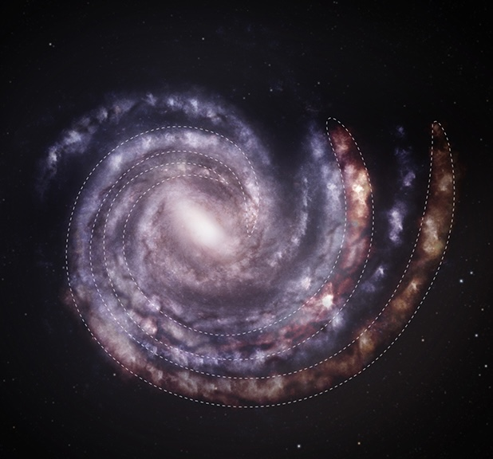
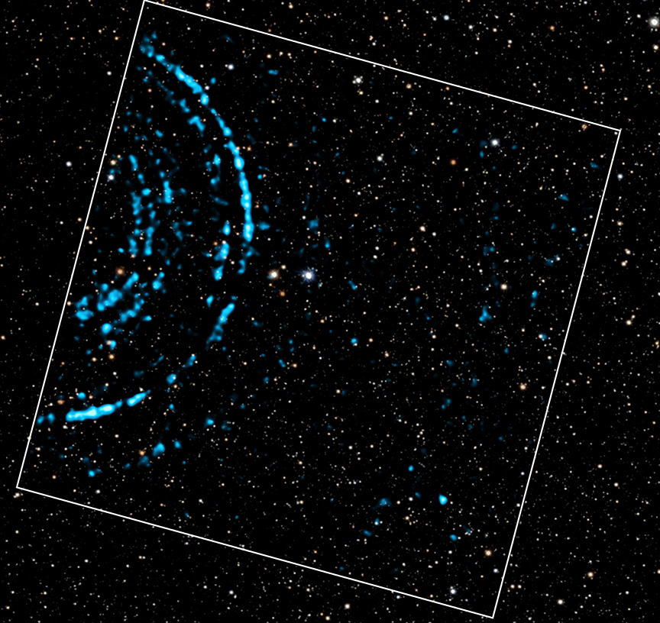
CHANDRA SCIENCE HIGHLIGHT: July 2026
National Aeronautics and Space Administration
NASA's Chandra Examines Milky Way at Arms' Length
The two outer spiral arms of the Milky Way galaxy may be farther away than scientists previously thought, by about 10%.
This discovery was made by measuring light echoes from distant gamma-ray bursts (GRBs) using NASA’s Chandra and ESA’s XMM-Newton.
Even a small change in the distance to these arms has a significant impact on our understanding of the Milky Way’s structure.
While this technique is powerful, GRBs are rare so it may be difficult to use them to measure distances to other spiral arms in the future.
Distance estimate: 62,000 light-years from Earth
Credit: X-ray: NASA/CXC/INAF/B. Vaia et al.; Optical: Pan-STARRS; Image processing: NASA/CXC/SAO/N.Wolk & P.Edmonds; Illustration: NASA/CXC/SAO/M.Weiss
Instrument: ACIS
Reference: B. Vaia et al. 2026, A&A, 710, 196
More information: The detailed caption and other material are here: https://chandra.harvard.edu/photo/2026/arms/
“…our galaxy just grew a bit.”
IFLScience
Left: An artist’s concept showing the Milky Way galaxy as seen from above, with the estimated positions of spiral arms based on previous data, in blue. Overlaid on this is an updated view of the Milky Way showing different positions (not drawn to scale) for the two outermost spiral arms, shown in red and bordered by dashed lines. Both arms may be more distant than previously thought, based on newly processed X-ray data from Chandra and XMM. Right: This image combines X-ray data from Chandra (blue) and optical data from Pan-STARRS (red, green and blue) showing X-ray rings. These rings were generated by light echoes when X-rays from a GRB struck dust clouds in different spiral arms of the Milky Way. The field of view of the Chandra image is shown by the angled white square.
The Chandra X-ray Center is operated for NASA by the Smithsonian Astrophysical Observatory

