Slide 1

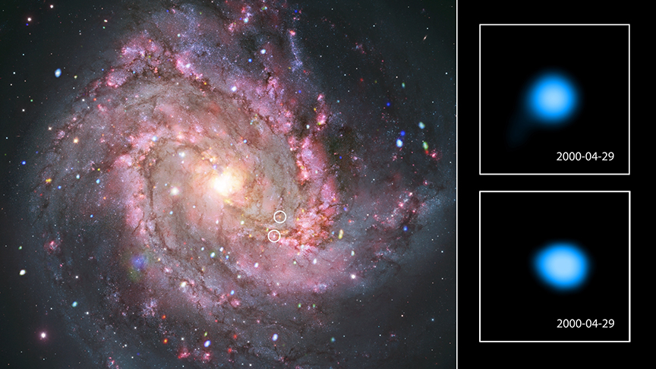
CHANDRA SCIENCE HIGHLIGHT: June 2026
National Aeronautics and Space Administration
NASA's Chandra Finds Unexpected Fireworks in Aftermath of Stellar Explosions
Astronomers have uncovered a population of sources associated with supernova remnants in a nearby galaxy that are unexpectedly changing in X-ray brightness.
Using data from NASA’s Chandra X-ray Observatory spanning 14 years, researchers found 22 sources associated with supernova remnants that brighten and dim dramatically in X-rays.
Typically, supernova remnants over a hundred years old just steadily decrease their X-ray output over time.
The researchers think this unusual behavior may come from stellar companions to the supernovas that survived the explosions. Matter is then being pulled away from these stars by the neutron stars or black holes that formed in the supernova.
Distance estimate: 15 million light-years from Earth
Credit: X-ray: NASA/CXC/SAO; Optical: NASA/ESA/AURA/STScI, Hubble Heritage Team, W. Blair (STScI/Johns Hopkins University) and R. O'Connell (University of Virginia); Image Processing: NASA/CXC/SAO/A. Jubett, L. Frattare and P. Edmonds
Instrument: ACIS
Reference: Prestwich, A. et al., 2026, ApJ, 1004, 154.
More information: The detailed caption and other material are here: https://chandra.harvard.edu/photo/2026/m83/
“…unexpected pyrotechnics from the aftermath of a supernova”
Popular Science
This graphic of Messier 83 (M83) shows two of the X-ray sources in this galaxy that are changing their brightness in surprising ways. Using data from Chandra researchers found over 20 sources associated with supernova remnants — remains from stars that exploded — that vary unexpectedly in X-rays, representing roughly half of the supernova remnants in their sample in M83. The panel on the left contains a composite image of M83 with X-rays from Chandra (point sources in red, green, and blue) and optical light data from NASA’s Hubble Space Telescope (red, green, and blue). Two of the varying Chandra sources are circled in the composite image and the first images in timelapse video of these sources are shown in the panels on the right. (The video is available here: https://chandra.si.edu/photo/2026/m83/).
The Chandra X-ray Center is operated for NASA by the Smithsonian Astrophysical Observatory

