Slide 1

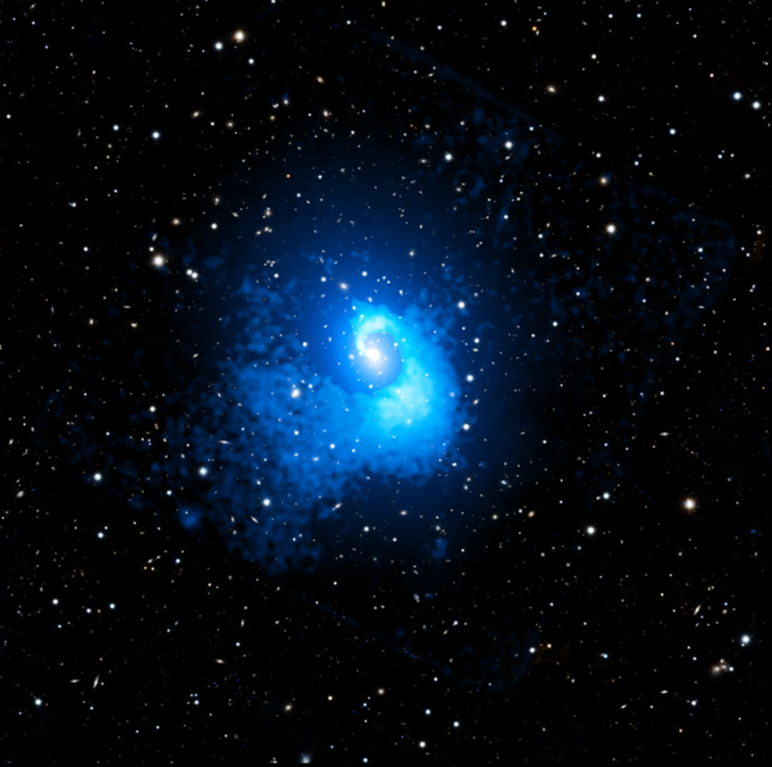
CHANDRA SCIENCE HIGHLIGHT: May 2026
National Aeronautics and Space Administration
Galaxy Cluster Relaxed Now, but was Wild in the Past
New data from NASA’s Chandra X-ray Observatory suggests an event-filled past for the galaxy cluster Abell 2029.
Known as one of the most relaxed clusters in the universe, the X-rays reveal evidence for a collision with a smaller cluster about four billion years ago.
A sloshing spiral structure was formed when the smaller cluster made its first pass through Abell 2029, pulling its gas sideways.
Galaxy clusters are the largest structures in the Universe held together by gravity and are bellwethers for cosmic growth.
Distance estimate: 1.0 billion light-years from Earth
Credit: X-ray: NASA/CXC/CfA/C. Watson et al.; Optical: PanSTARRS; Image Processing: NASA/CXC/SAO/N. Wolk and P. Edmonds
Instrument: ACIS
Reference: Watson, C.B., et al., 2026, ApJ, 996, 106.
More information: The detailed caption and other material are here: https://chandra.harvard.edu/photo/2026/a2029/
This new composite image shows evidence for Abell 2029’s violent past in the nautilus-like shape in the Chandra data (blue). Optical light from stars and galaxies in the same field of view appears mainly white in an image from Pan-STARRS, a telescope in Hawaii. Researchers think the spiral shape in the hot gas formed when gas in the cluster sloshed to the side because of the gravitational effects of the cluster collision — similar to how wine moves in a wine glass.
The Chandra X-ray Center is operated for NASA by the Smithsonian Astrophysical Observatory

